Slide 1
Rockbuster Analysis
Isaac Gonzalez
gonzaisa04@gmail.com

Slide 2
New Data Profile
*Most common rating is PG-13
*Average Rental Duration is 4.99 days

Slide 3


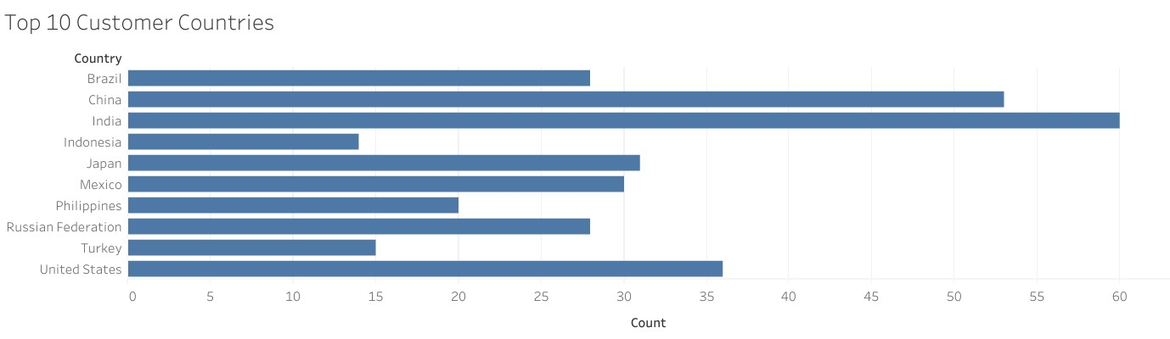



Top 10 Customer Countries
*India is #1

Slide 4
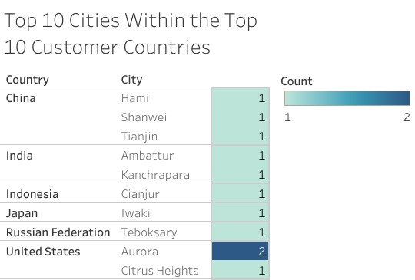
Top 10 Cities within
United States has 2 Top 10 cities

Slide 5
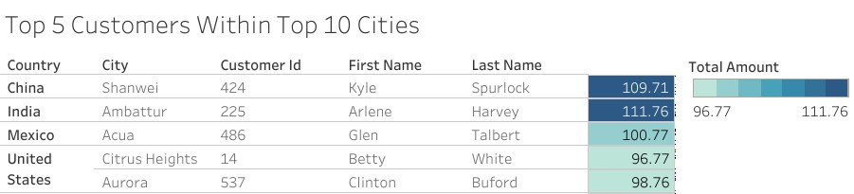
Top 5 Customers
*India’s Arlene Harvey is spending the most between customers in the Top 10 cities

Slide 6
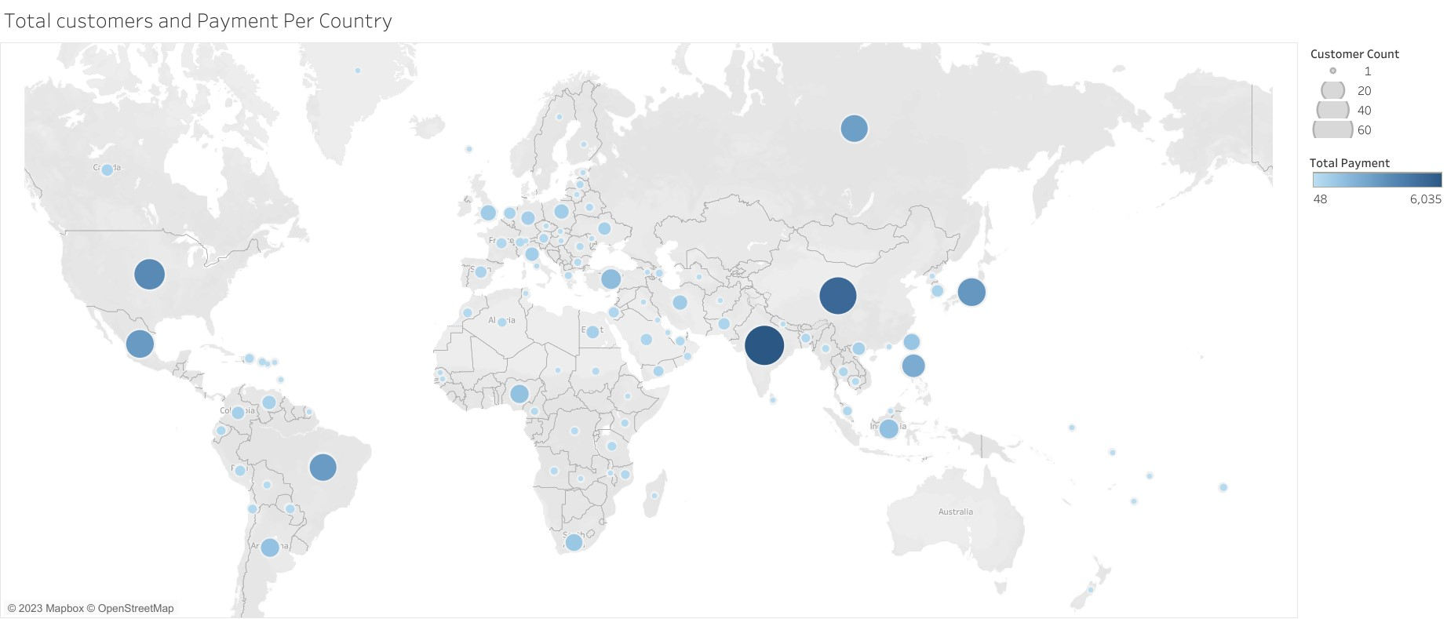
Total Customers and Payment Per Country https://public.tableau.com/views/CustomersPaymentPerCountry/Sheet1?:language=en-US&:display_count=n&:origin=viz_share_link

